Slide 1
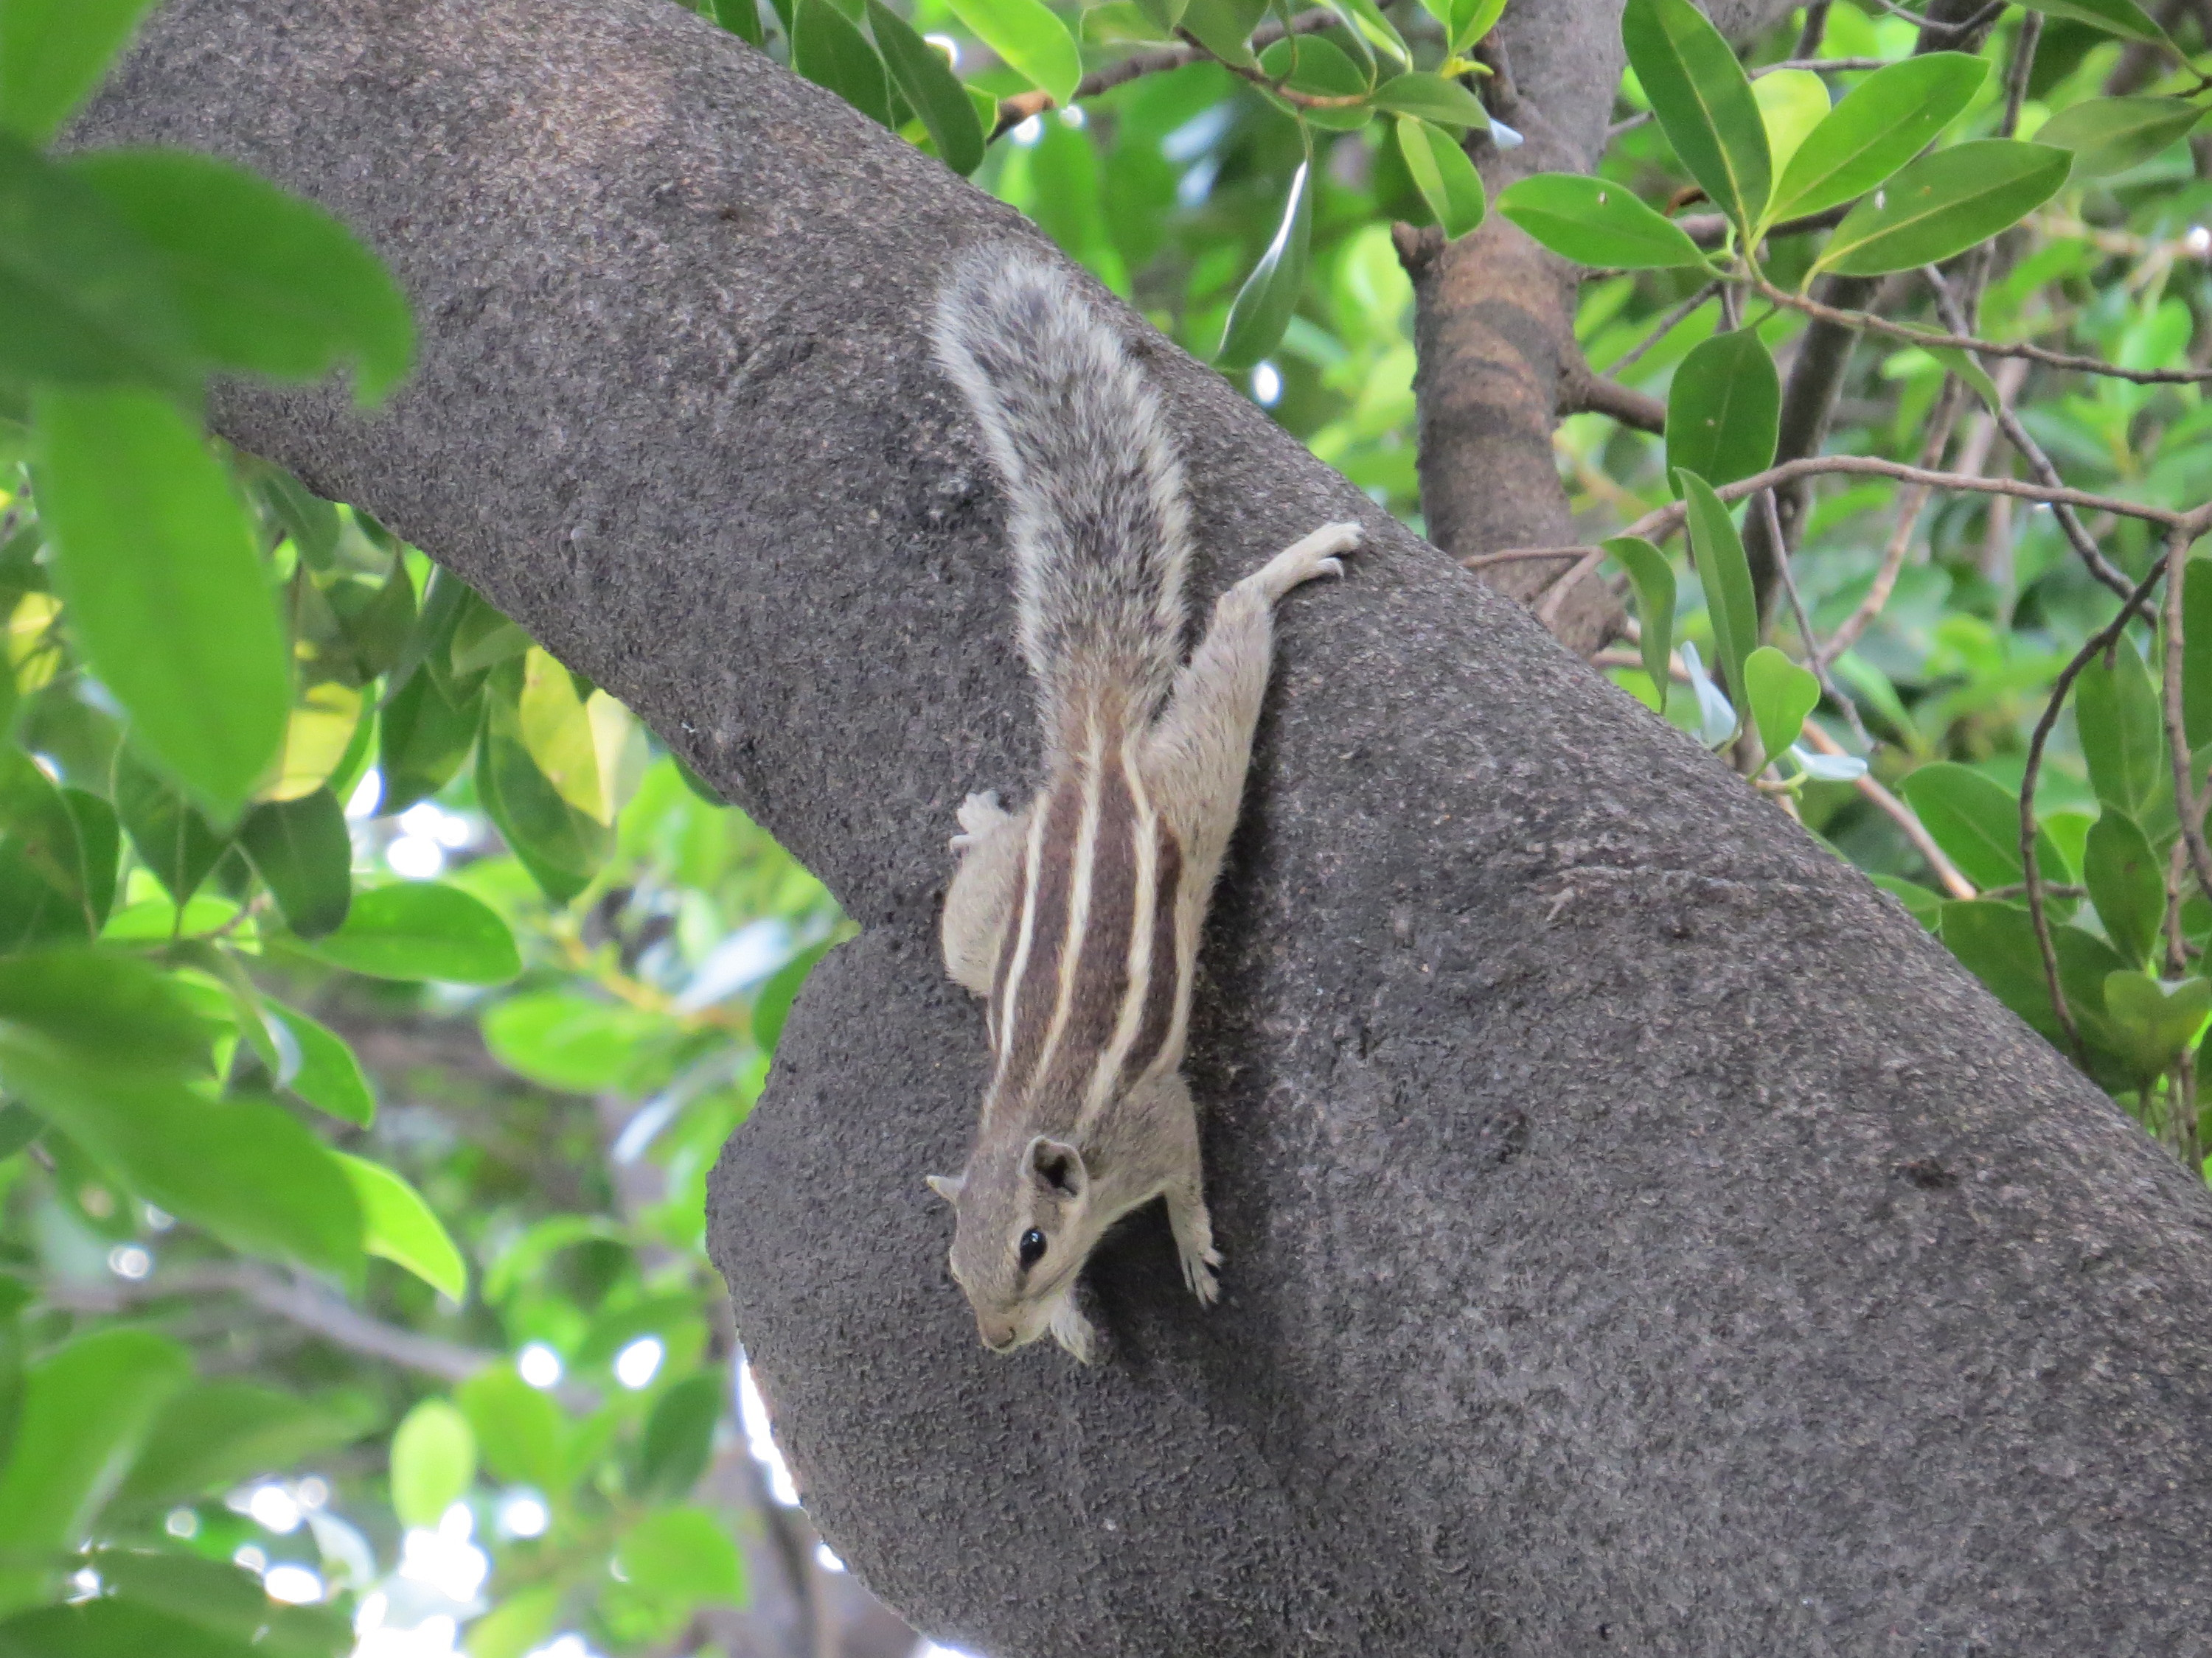
GBIF Today and Tomorrow
Donald Hobern, GBIF Executive Secretary
Science Symposium, New Delhi, India, 17 September 2014

Slide 2
Concern – Prescence-only data
To monitor biodiversity trends, we need more than just presence data

Slide 3
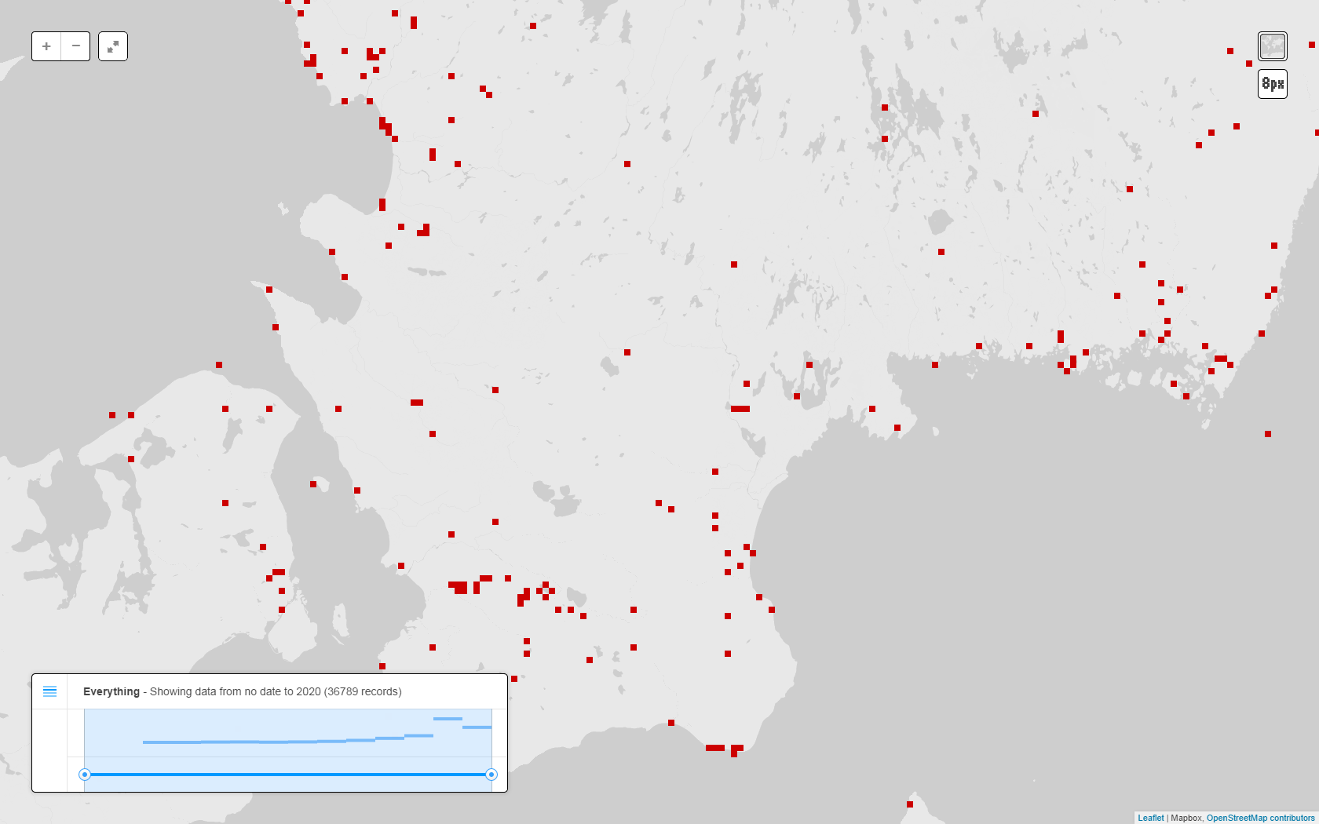
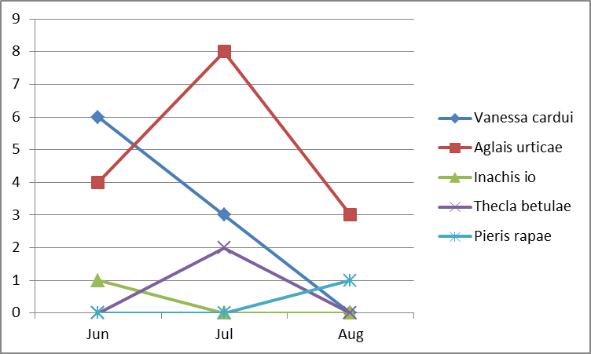
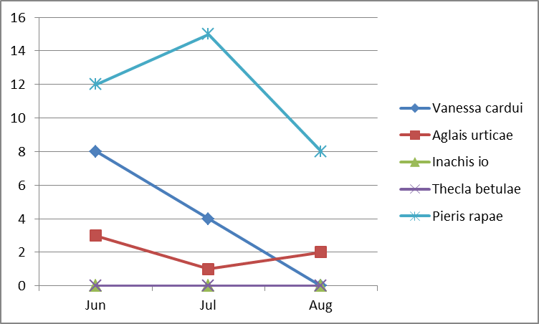
Extending GBIF for sample-based data
Species | Event | Quantity | Sample size | Protocol
Vanessa cardui | PlotA-2014-06 | 6 individuals | 1 km | Butterfly transect
Aglais urticae | PlotA-2014-06 | 4 individuals | 1 km | Butterfly transect
Inachis io | PlotA-2014-06 | 1 individual | 1 km | Butterfly transect
Species | Event | Quantity | Sample size | Protocol
Vanessa cardui | PlotA-2014-07 | 3 individuals | 1 km | Butterfly transect
Aglais urticae | PlotA-2014-07 | 8 individuals | 1 km | Butterfly transect
Thecla betulae | PlotA-2014-07 | 2 individuals | 1 km | Butterfly transect
Species | Event | Quantity | Sample size | Protocol
Pieris rapae | PlotA-2014-08 | 1 individuals | 1 km | Butterfly transect
Aglais urticae | PlotA-2014-08 | 3 individuals | 1 km | Butterfly transect
Comparable
Species | Event | Quantity | Sample size | Protocol
Pieris rapae | PlotB-2014-06 | 12 individuals | 1 km | Butterfly transect
Vanessa cardui | PlotB-2014-06 | 8 individuals | 1 km | Butterfly transect
Aglais urticae | PlotB-2014-06 | 3 individuals | 1 km | Butterfly transect
Species | Event | Quantity | Sample size | Protocol
Pieris rapae | PlotB-2014-07 | 15 individuals | 1 km | Butterfly transect
Vanessa cardui | PlotB-2014-07 | 4 individuals | 1 km | Butterfly transect
Aglais urticae | PlotB-2014-07 | 1 individuals | 1 km | Butterfly transect
Species | Event | Quantity | Sample size | Protocol
Pieris rapae | PlotB-2014-08 | 8 individuals | 1 km | Butterfly transect
Aglais urticae | PlotB-2014-08 | 2 individuals | 1 km | Butterfly transect
Not comparable
Species | Event | Quantity | Sample size | Protocol
Platichthys flesus | DiveX-20120301 | 3 individuals | 500 m2 | Fish dive survey
Sprattus sprattus | DiveX-20120301 | 71 individuals | 500 m2 | Fish dive survey

Slide 4
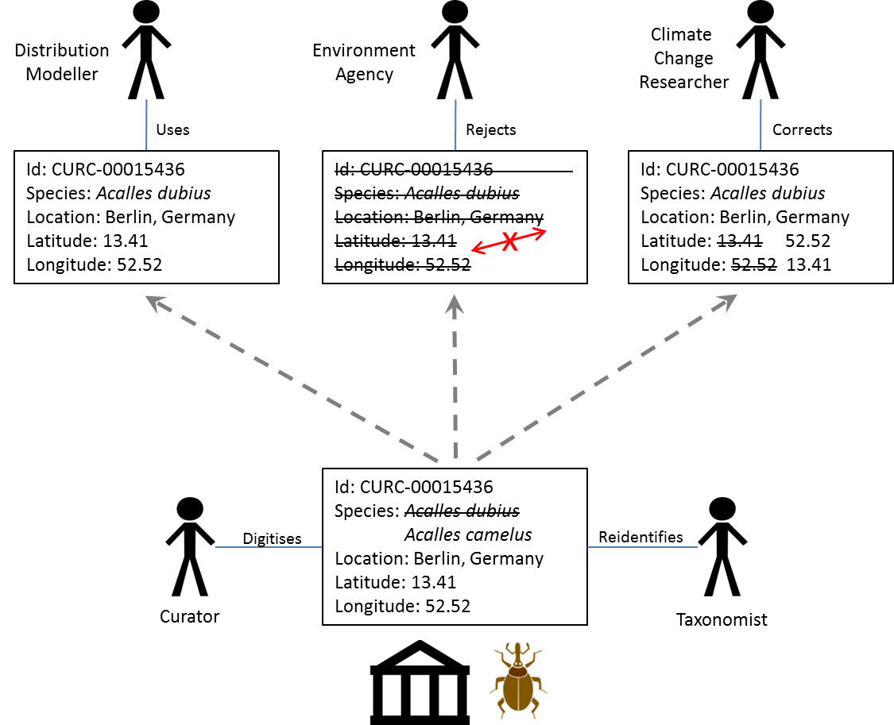
Concern – Disconnected data
It is hard for data publishers to know how their data have been used
Researchers can’t fix problems with data

Slide 5
GBIF and Digital Object Identifiers
DOI – Digital Object Identifier
Persistent resolvable identifiers
Standard for published papers
Simplify citing references
Used in measuring impact

Slide 6
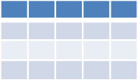
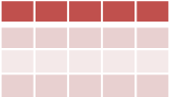
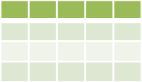
GBIF and Digital Object Identifiers
GBIF.org
DataCite Denmark
GBIF registers datasets
without existing DOIs
with DataCite Denmark
IPT
Any tool
Any tool
National DataCite Service
Publisher uses IPT to register dataset with DataCite
Publisher establishes DOI externally
Publisher does not provide DOI
Data Publishers

Slide 7
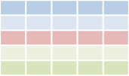
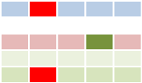
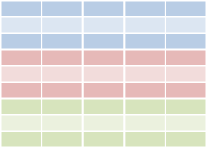
GBIF and Digital Object Identifiers
GBIF download
Cleaned data
Paper
Download DOI
Dataset DOI
Paper DOI
Data
Data
User publishes paper
Published paper can give resolvable links to GBIF download and/or to cleaned dataset
User cleans data
Researcher
Data attribution
Data attribution
User searches for data through GBIF.org
User deposits cleaned dataset in a repository and gets DOI for dataset
GBIF.org
Download history
Download 1
DataCite Denmark
. . .
GBIF assigns DOIs to
data downloads
GBIF.org creates a download data set

Slide 8
GBIF and Digital Object Identifiers
GBIF download
Cleaned data
Paper
Researcher
Reader
Download DOI
Dataset DOI
Paper DOI
Data
Data
Cite data sources
Linked results to data
Suggest data corrections
Retrieve source data
Reproduce results
Data attribution
Data attribution
Data Publisher
GBIF.org
GBIF
Download history
Download 1
. . .
Discover data usage
Receive suggested data corrections
Monitor data usage
Enhance fitness-for-use
IPT
Any tool
Any tool

Slide 9
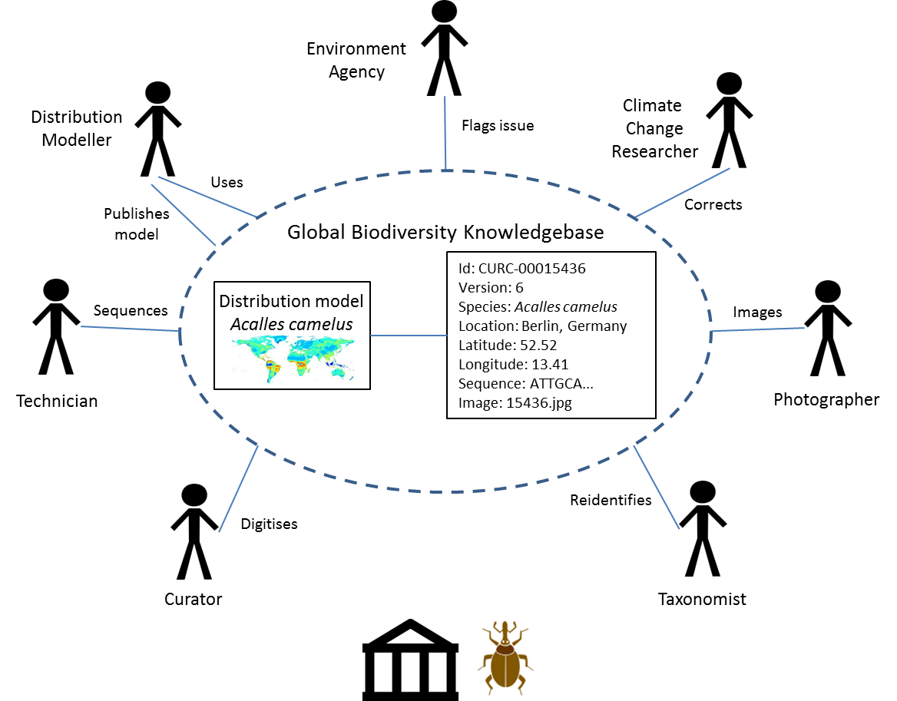
Concern – Fitness-for-use
GBIF does not yet make use of all relevant expert knowledge to improve data

Slide 10
GBIF and GLOBALLY CONNECTED DATA
Species Occurrence Catalogue
Taxon Name Catalogue
GBIF Data Index
Catalogue of Life
Institution Catalogue
Collection Catalogue
Taxon Concept Catalogue
Sequence Catalogue
Publication Catalogue
Comprehensive
service-centred catalogues
GBIF in future should use services from a shared catalogue to get the best concept (and to add it if not already included)
Published data sets
Catalogues with compatible services form an ecosystem to organise access to distributed biodiversity information
Catalogues are also best place of offer tools and services to support and organise annotations and corrections
Species
Occurrence
Taxon
Name
Institution
Collection
Taxon
Concept
Species occurrence record includes scientific name and no explicit species concept
Sequence
Publication
Conceptual biodiversity data model

