Slide 1
Collections support through NSF as it applies to data integration and attribution
BCoN Data Integration Workshop, University of Kansas, Feb 13-14, 2018
Reed Beaman
Program Director
Division of Biological Infrastructure
Directorate for Biological Sciences
National Science Foundation

Slide 2
NSF Division of Biological Infrastructure: Programs supporting collections
CSBR – Collections in Support of Biological Research
Natural History
Living Stocks
Transfer of Ownership
ADBC – Advancing Digitization of Biodiversity Collections
TCNs – Thematic Collections Networks
PENs – Partners to Existing Networks

Slide 3
Some relevant programs, initiatives
Advances in Biological Informatics
Innovation, Development, and Sustaining Tracks
Research Coordination Network (RCN)
CAREER
REU Sites
Postdoctoral Research Fellowships in Biology (PRFB)
Collections
Broadening Participation
Undergraduate Biology Education (UBE)
Curriculum dev, training
NEON, Macrosystems, Edge, Dimensions

Slide 4
What’s coming up?
No deadlines for core programs, including CSBR, ABI – existing solicitations archived
Look for new programs/solicitations in DBI.
ADBC keeps annual deadline
nearing a 10 year run
What follows?

Slide 5
Demonstrate relevance to NSF-BIO funded research
Innovation
New types of collections
From field to data stream
Rules of life
Building capacity
Improving, securing, and making collections more accessible
Orphaned collections, project collections, and the backlog created by successful research
Use and benefit beyond the collections community

Slide 6
Questions
Have investments by NSF and other U.S. agencies led to integrated common standards and practices that support increased accessibility?
What future innovation in biological collections will advance research over the next decade?
What strategies will facilitate the use of collections in research and education?
What new avenues of inquiry address issues of broad societal importance, e.g., global environmental change, food security, conservation, and the bio-economy?
What will enable institutions with biological collections to monitor, assess, and modify the value and impact of their collections and their strategies to facilitate novel and continued use?

Slide 7
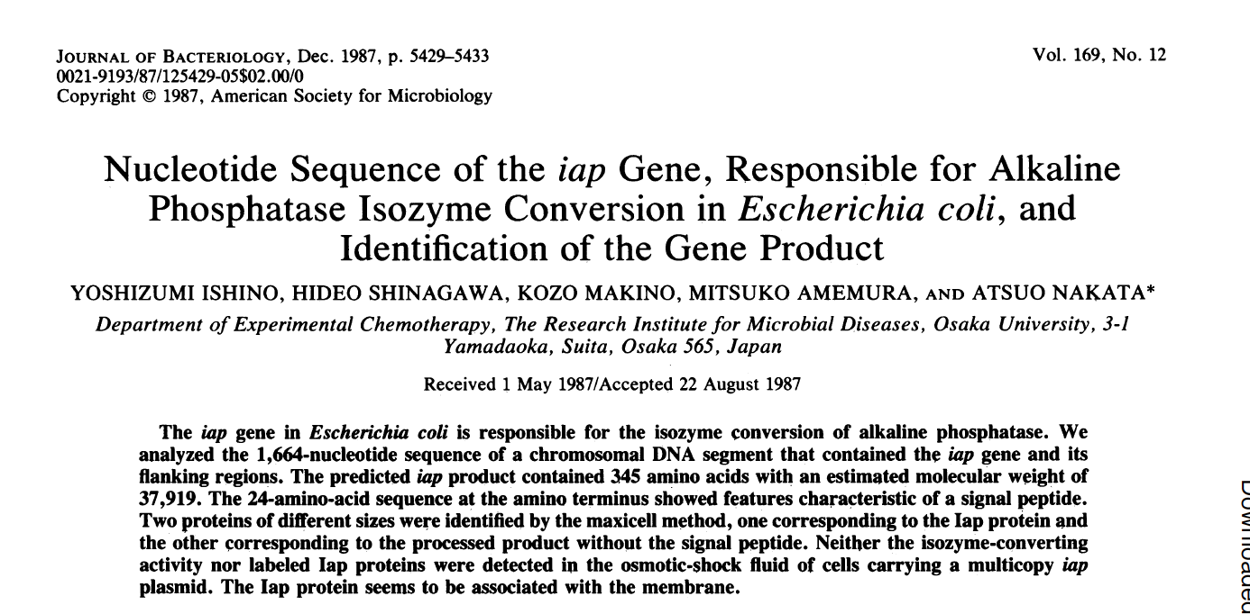
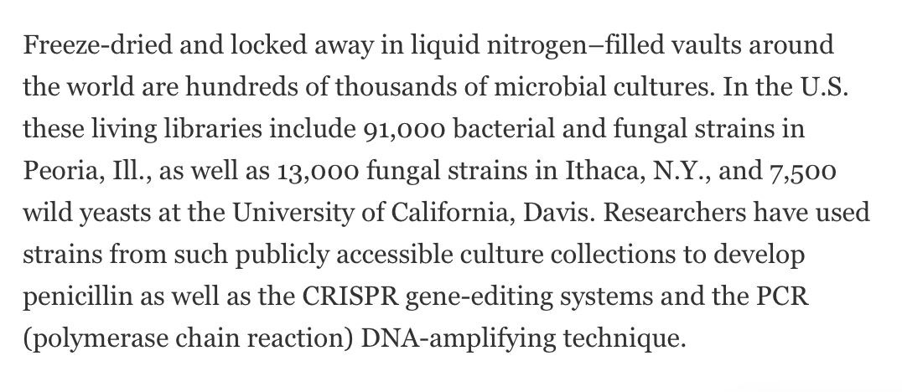
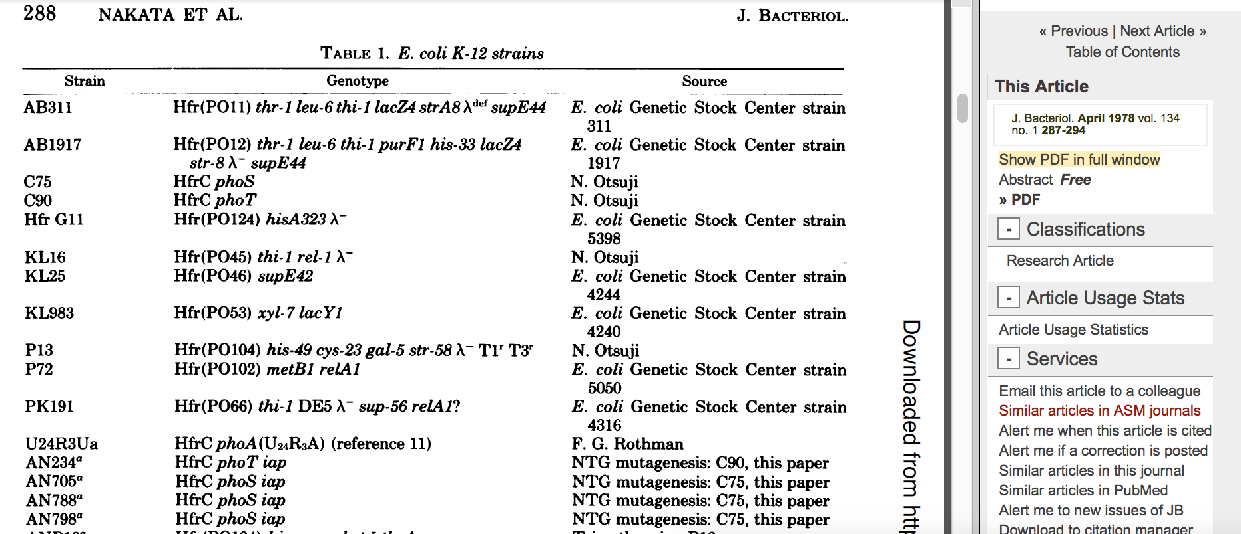

Slide 8
NSF Ten Big Ideas

Slide 9
Understanding the Rules of Life: Predicting Phenotype
https://oadblog.nsfbio.com/2015/07/01/team_science/
National Academies, Division of Behavioral and Social Sciences and Education. The Science of Team Science, Project Scope: http://sites.nationalacademies.org/dbasse/bbcss/currentprojects/dbasse_080231
http://www.sciencemag.org/sites/default/files/documents/Big%20Ideas%20compiled.pdf
”The universally recognized biggest gap in our biological knowledge is our inability to predict the phenotype of a cell or organism from what we know about the genome and environment. The traits of an organism are emergent properties of multiple types of information processed across multiple scales, e.g., biophysical, genomic, evolutionary, ecological, environmental, time. It is an enormous challenge to unravel because of the complexity of information and nonlinear processes involved; we simply do not understand the rules that govern phenotypic emergence at this scale. Unpacking phenotypic complexity will require convergence of research across biology, computer science, mathematics, the physical sciences, behavioral sciences and engineering.”
http://www.sciencemag.org/sites/default/files/documents/Big%20Ideas%20compiled.pdf

Slide 10
Key Questions (for RoL)
How can computational modeling and informatics methods enable data integration for the purpose of analysis and prediction of complex living systems?
Variation in traits expressed by organisms is a feature of all life; what are the genetic, epigenetic and environmental factors that explain its magnitude and occurrence?
How to predict the behavior of living systems, from single molecules to whole cells, whole organisms, and whole ecosystems? To what degree do group interactions and behavior affect phenotypic expression?
To what degree is an organism’s phenome a result of the microorganisms that live in symbiosis with it? To what degree is the production of a phenotype a joint effort’ among genomes of different organisms?
Can we synthesize cells and organisms based on knowledge of genome sequence and physical features of other basic molecules?
http://www.sciencemag.org/sites/default/files/documents/Big%20Ideas%20compiled.pdf

Slide 12
Cyberinfrastructure for Sustained Scientific Innovation (CSSI) - CISE/Cross-cutting
Combines DIBBS and SSI
Planning Grants for Community Cyberinfrastructure (either Community Data Cyberinfrastructure Planning Grants or Community Software Cyberinfrastructure Planning Grants): Planning awards focus on the establishment of long-term capabilities in cyberinfrastructure, which would serve a research community of substantial size and disciplinary breadth.

