Slide 1
Portal Statistics: Biting the hand that feeds
David Bloom
http://vertnet.org
http://portal.vertnet.org

Slide 2
Characteristics of Statistics
Content
Delivery
Access

Slide 3
Content
VertNet provides statistics requested by the community.
Community-wide surveys
Direct requests by collections
Regular feedback

Slide 4
Delivery
VertNet provides:
High-level view via portal
Detailed text document via GitHub

Slide 6
Text document in GitHub:
← Those 5 stats, plus:
Institution name
Time period
List of queries that retrieved data from the resource
Number of download events that retrieved data from the resource
Total number of records downloaded
Number of different countries
Origin of the queries that retrieved data from the resource
Dates of the queries that retrieved data from the resource

Slide 7
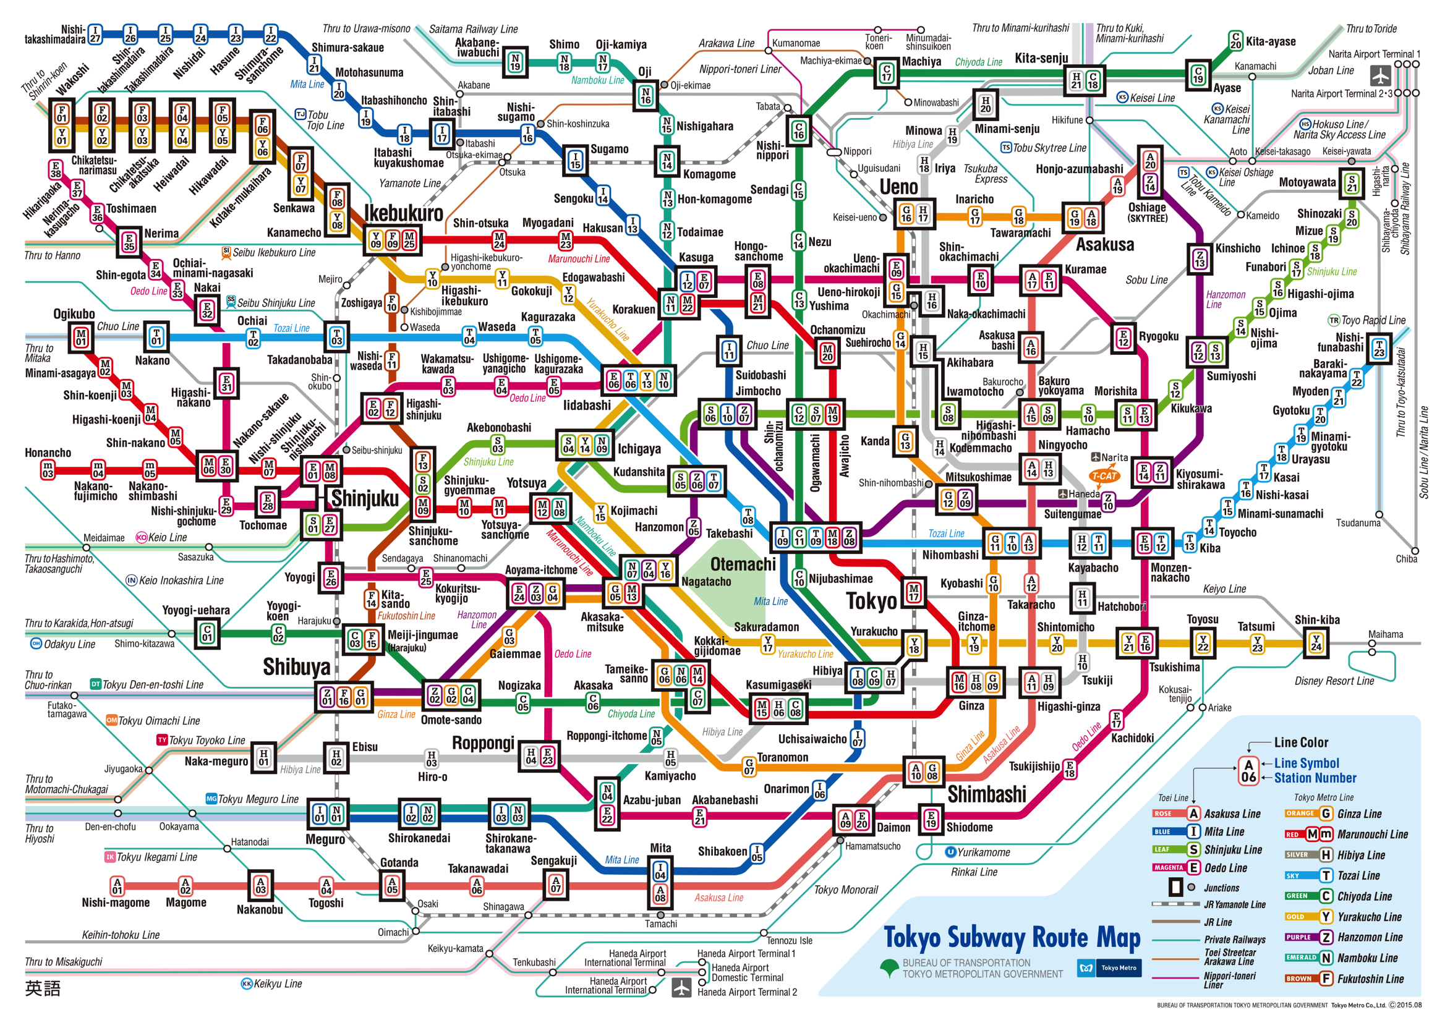
Access
Can data publishers find the statistics?

Slide 8
Digital Hide-and-Seek

Slide 9
Hiding in plain sight

Slide 10
But, are statistics useful?
Maybe….

Slide 11
But, are statistics useful?
Probably….

Slide 12
But, are statistics useful?
Yes!!!

Slide 13
Why?
The community has asked for them
over and over and over and over…
Data publishers need them.
Portals have the numbers.
It’s easy.

Slide 14
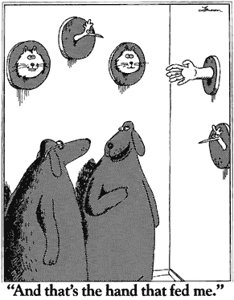
Why?

Slide 15
But statistics are not enough

Slide 16
But statistics are not enough
Statistics don’t show:
Actual use
Influence
Difference-making

Slide 17
We need more

Slide 18
We need more

Slide 19
We need more

Slide 20
We need more

Slide 22
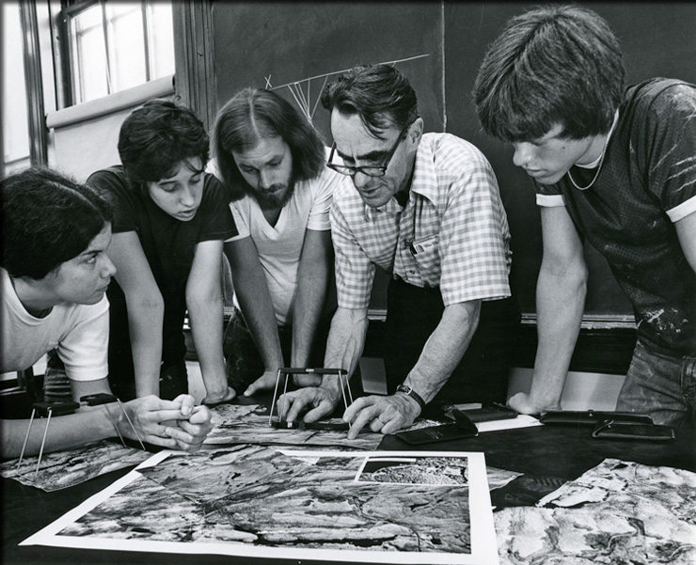
It’s on us

Slide 23
Useful Links
Dimensions - https://www.dimensions.ai/
Shorthouse/CMN GitHub - https://github.com/mus-nature-ca/museum-tracker
VN portal - http://portal.vertnet.org/search
dbloom@vertnet.org

