Slide 1
Proposed redevelopment of GBIF data integration pipeline
Donald Hobern, GBIF Executive Secretary
Macropus robustus Gould, 1841, subspecies erubescens, Euro, Denham, WA, Australia, 10 January 2018

Slide 2
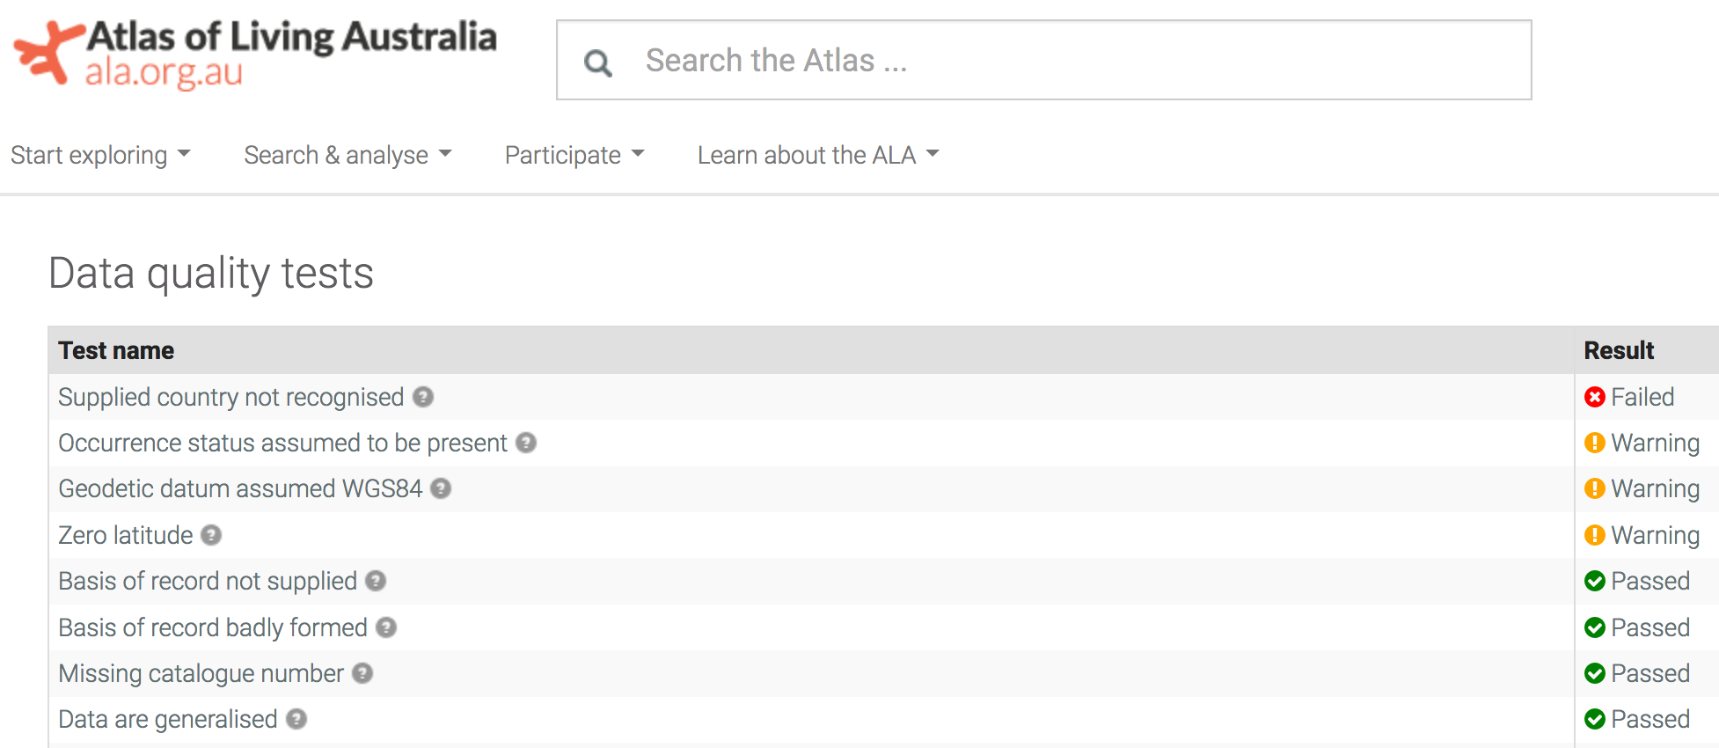
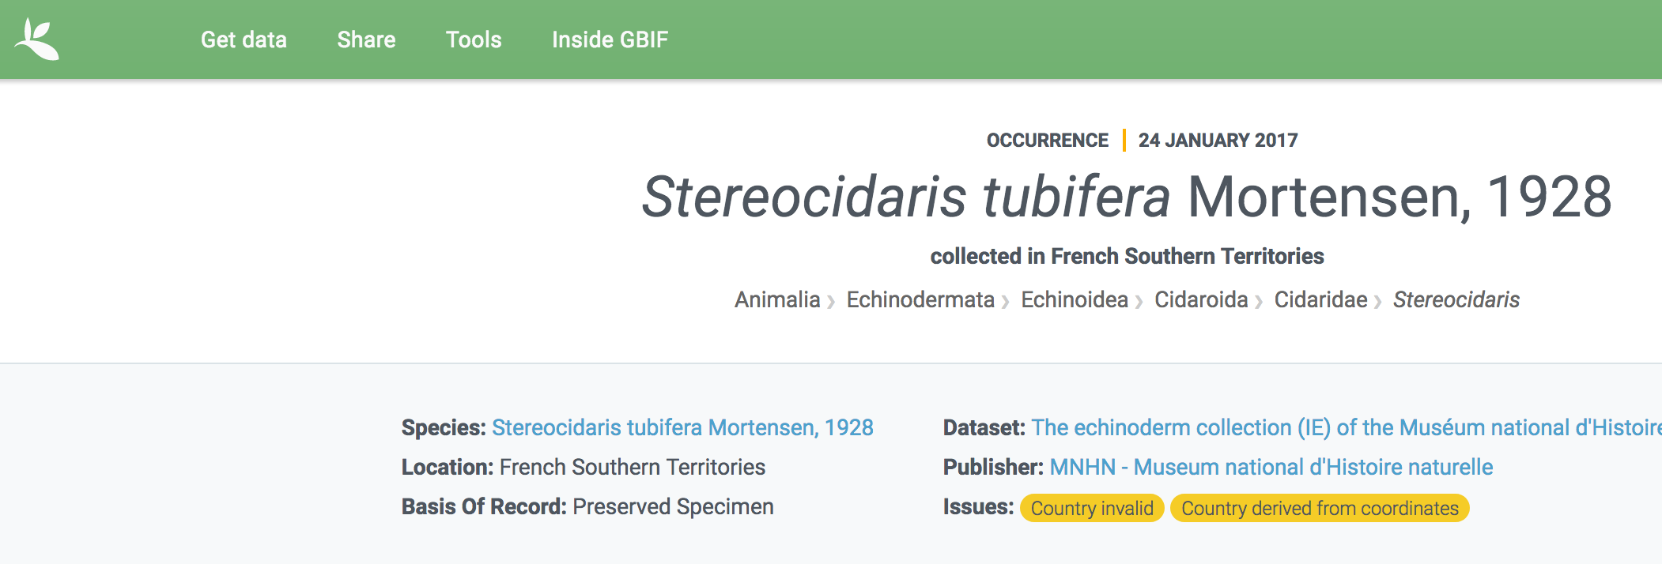
informatics and data priorities
Re-engineering data indexing: current situation
DwC-A
IPT
Validations
Data cleaning and Interpretation
Data store
API
ALA Portal
Temporal, geographic, taxonomic, identification…
DwC-A
IPT
DiGIR
BioCASE
TAPIR
Validations
Data cleaning and interpretation
Data store
API
GBIF Portal

Slide 3
informatics and data priorities
Re-engineering data indexing: architecture vision
Development status: exploration, proof of concept and technical assessment
Extensible data pipeline
Record Level
Geographic
ALA Platform
Temporal
DwC-A
IPT
DiGIR
BioCASE
TAPIR
Common data format
GBIF Platform
Taxonomic (pluggable)
* Platform
Custom extensions e.g.
Red list
Protected areas
DwC Extension

Slide 4
elements OF COMBINED data indexing
All records handled as an identifier, associated with the verbatim record and a bag or normalised, interpreted properties (including annotations from various sources)
Ensure all records are associated with a stable globally shared unique identifier
Consistent, transparent, well-documented standard data checks
Normalisation against “consensus” global classification
National-scale properties for e.g. state/province identifiers, national species lists
Taxon- or Theme-relevant additional processing for e.g. additional properties for TCN taxa, paleo records, herbarium sheets
Clustering of records likely to be from same collecting/observing event
Higher-level validation across a dataset or per taxon

Slide 5
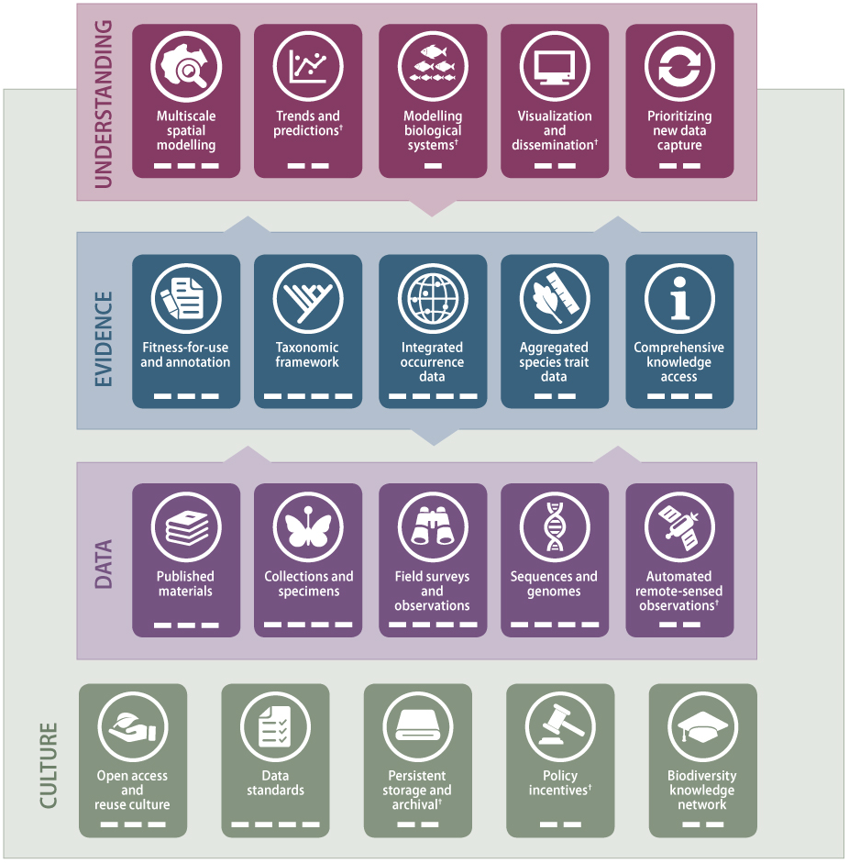
GBIO Components

Slide 6
GBIC2: Coordinating GBIO Implementation
Project
Office
Coordinates
Consultation Process
Expert
Group
Roadmap
Draft
Roadmap
Wide
Consultation
Governance
Technical Support
Communication
Coordinating Mechanism
Funding and Sustainability
Best Practices

Slide 7
GBIC2: Coordinating GBIO Implementation
Project
Office
Governance
Technical Support
Communication
Coordinating Mechanism
Funding and Sustainability
Best Practices

Slide 8
GBIC2: Fundamental Requirements
Transparency and clear governance
Open international collaboration
Mechanisms to support trust between stakeholders
Commitment to open access data culture
Development of a common conceptual outline
Credibility with governments and funding bodies
Credibility with researchers and scientific bodies

Slide 9
GBIC2: Issues to solve
Existing funding short-term project-based
Overlapping stakeholder mandates
Existing project timelines and milestones
Sustainability of components
Low levels of trust from researchers for “aggregators”
Handling competitive attempts to implement components
Limited engagement with some geographic regions
Challenges of multilingual collaboration

Slide 10
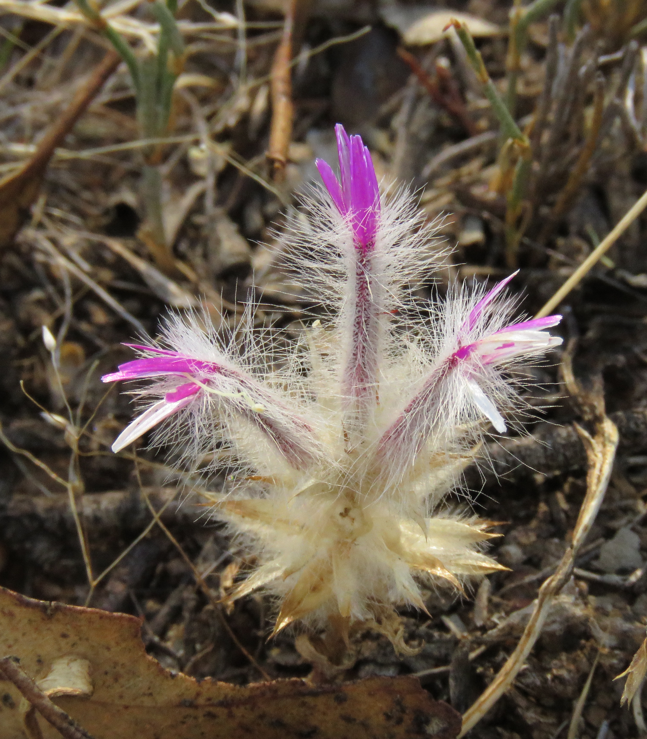
Thank you
Donald Hobern
GBIF Executive Secretary
dhobern@gbif.org
Notes:
GBIF exists to facilitate free and open access to biodiversity data in support of science and, through science, of science-based policy. The original OECD proposal for GBIF included an expansive vision for biodiversity content, including many areas which are now the domain of other international biodiversity informatics activities, including the Catalogue of Life, the Encyclopedia of Life, the Biodiversity Heritage Library and others.
GBIF itself serves as the global aggregation point for primary data on the occurrence of species, deriving mainly from natural history specimens and field observations. These data remain under the control of data publishing institutions located around the world. GBIF’s central services enable the data to be brought together and organised consistently to support user searches and downloads and to deliver basic GIS capability. Increasing numbers of peer-reviewed articles document research based on GBIF-mediated data.
GBIF has demonstrated the capability and effectiveness of its global network and of these data integration tools. Focus is now turning to improved understanding of the coverage and gaps in available data and to prioritising delivery of key data sets of high value to research. These priorities will include incorporating more detail on the sampling events from which many data records derive and on the representation of species abundance. GBIF will also work more closely with other biodiversity informatics activities to improve the interoperability between species occurrence data and other classes of biodiversity data.

Slide 11
GBIC2: Component Roadmaps
A
C
B
Define deliverables to be achieved
Identify known challenges and issues
Document existing standards and best practices
Identify existing infrastructures or tools for adoption/support/enhancement as components
Identify and describe missing components and required services
Identify dependencies or overlaps with other GBIO component areas

Slide 12
GBIC2: Funding Roadmap Implementation
International institutions and projects
Identify potential funding sources
Develop funding proposals to implement components
Plan sustainable delivery and long-term collaboration
Roadmap project office
Offer guidance on alignment with international plans
Coordinate letters of support from global community
International partners
Provide requirements / advice / implementation support
Align activities with funded components

